Slide 1
How to Keep a ScoreCard
Tom Richmond

Slide 2
History
Unclear advent date
Legend says 1839, Cooperstown New York
Invented in 1870s to simplify keeping stats for the morning paper
Technology advances have outdated process of scorekeeping
Still offered in all 30 Major League ball parks for fans

Slide 3

Baseball Statistics
Offensive Stats
RBIs, Hits, Runs, Walks, Outs, Strikeouts
Pitcher Stats
ERA, Strikeouts, Innings Pitched, Runs, Hits

Slide 4
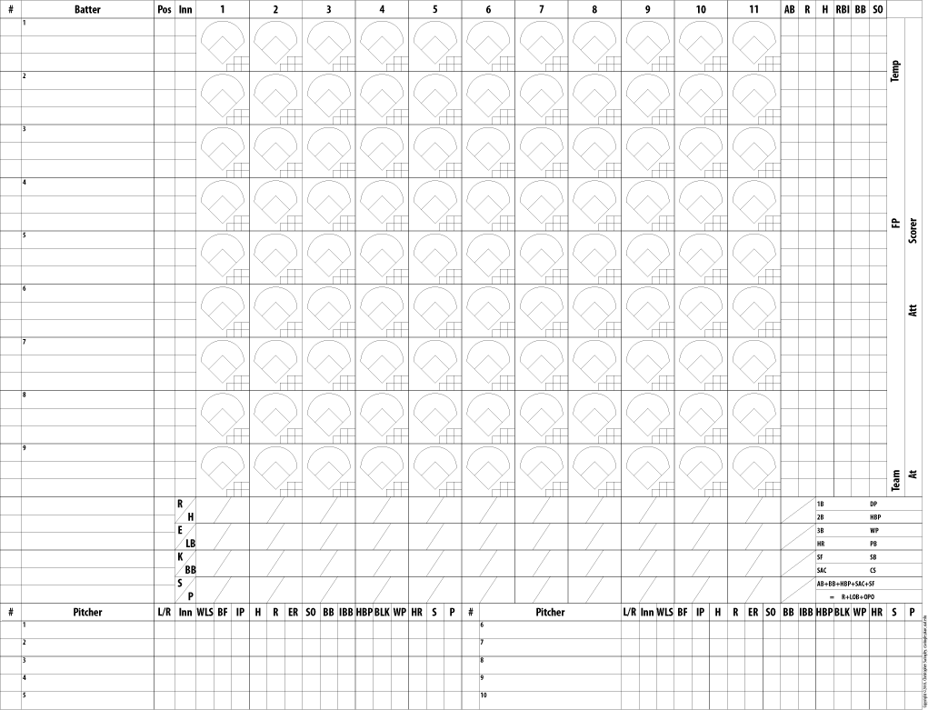
Sheet Style
Two of the shown sheet, one for each offense
Each player name, number and position on left
Pitcher name on bottom
Optional:
Umpires, game time, weather, location

Slide 5
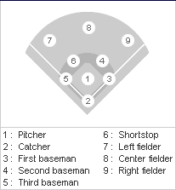
Player Identification
Nine defensive players on the diamond
One batter at a time
Numbers used to simplify the scorekeeping process

Slide 6
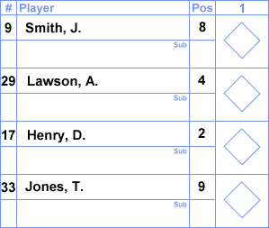
Batting Statistics
Possible batter outings:
Hit
Record the base they reached. 1B = Single, 2B=Double
Walk
Mark with BB
Out
Strikeouts recorded with a ‘K’ (backward while looking)
If out by tag or caught ball, record players involved in play
Use player number identification (Ex. F6, 5-3)

Slide 7
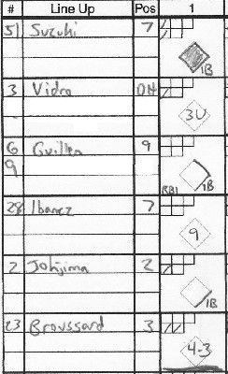
Inning Example
Suzuki singles
Vidra out (1), unassisted by first base
Guillen singles, scores RBI
Ibanez flies out (2) to left field
Johjima singles
Broussard out (3), second base to first base
End of Inning

Slide 8

Pitcher Statistics
Wait until the end of their outing to score
Pitcher wins if:
Team wins game
Was pitcher of record when team took lead, and didn’t relinquish
Starting pitcher pitched five full innings
Relief Pitcher when team took lead

